Slide 1

The Unified Modeling Language
An Introduction

Slide 2

Agenda
Background
Things
Relationships
Summary

Slide 3
Background
Pictures are Nice
The Unified Movement
  Three Amigos
    Booch, Rumbaugh, Jacobson
UML is a melding of other Notations
  A Graphical Language, not a Methodology
  Complex
  Just use what you need

Slide 4
Things
Parts/Views of a System
Three Categories of Diagrams
  Structural
  Behavioral
  Grouping

Slide 5
Structural Diagrams
Use Case
Class
Interface
Component
Collaboration

Slide 6
Use Cases
Documents a user’s interaction with the system
  An external view
Often just recorded in text
Diagrams can get very complex

Slide 7
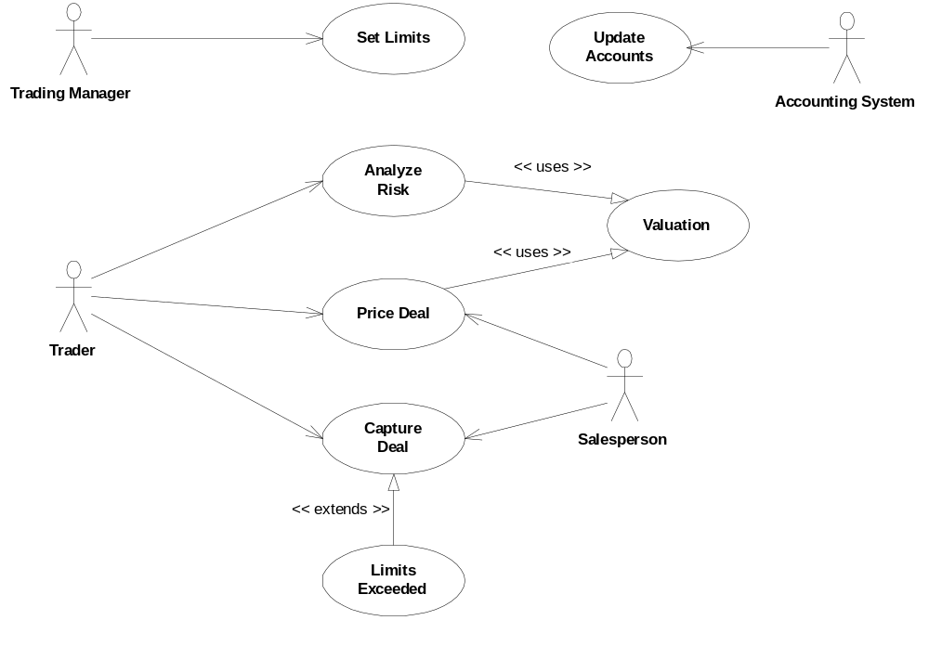
Use Case Diagram

Slide 8

Class Diagrams
Denotes key system abstractions and their static relationships
  associations
  subtypes
Crucial for an overall “picture” of the system
Can capture different levels of granularity
  views with increasing detail
    Conceptual (Domain View)
    Specification (Class Interfaces)
    Implementation (Hidden Attributes & Behavior)
Often the starting point for implementation

Slide 9
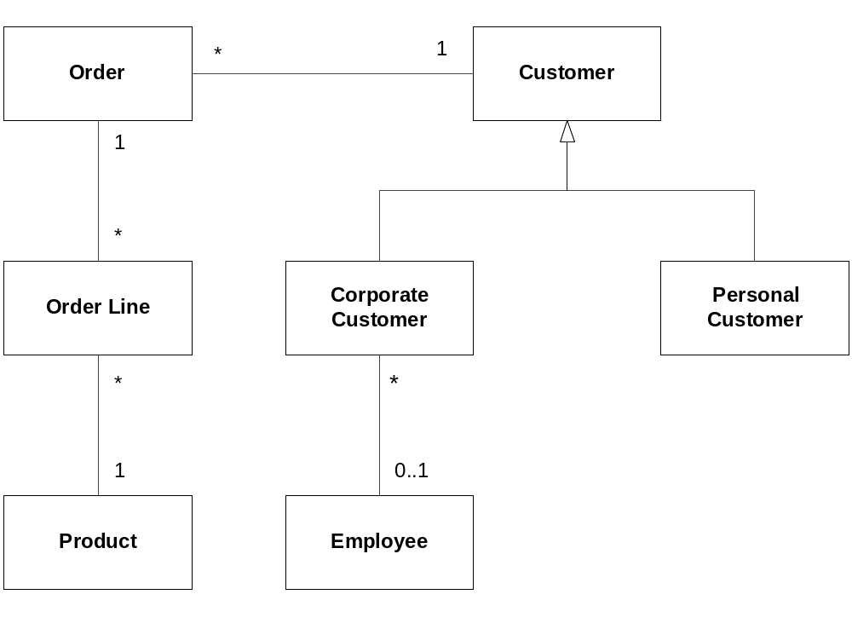
Conceptual Class Diagram

Slide 10
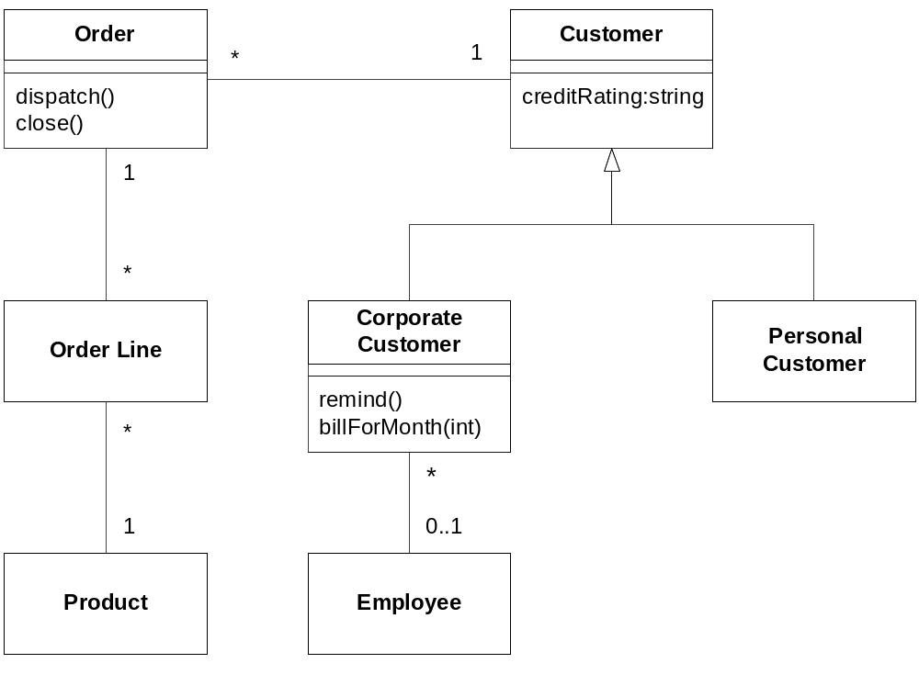
Specification Class Diagram

Slide 11
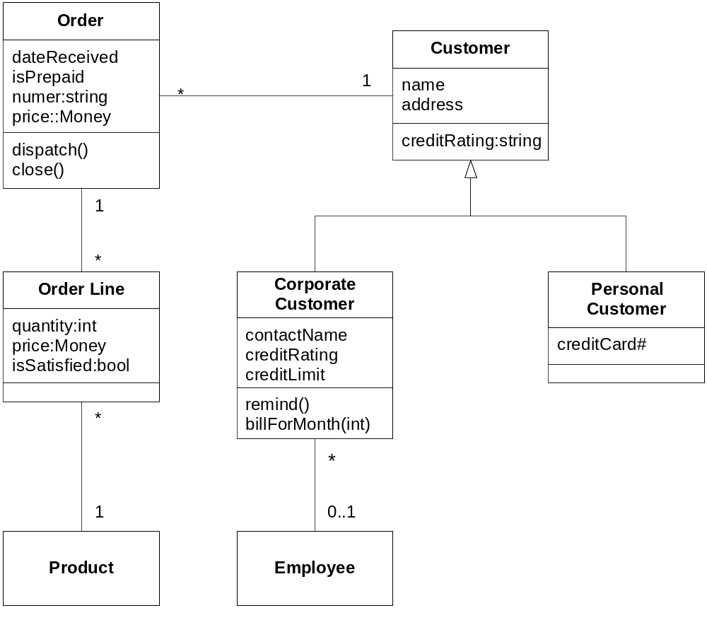
Implementation Class Diagram

Slide 12
Interfaces
Define external behavior
  A set of methods
Key to Distributed Programming
  COM
  CORBA
  Java RMI

Slide 13
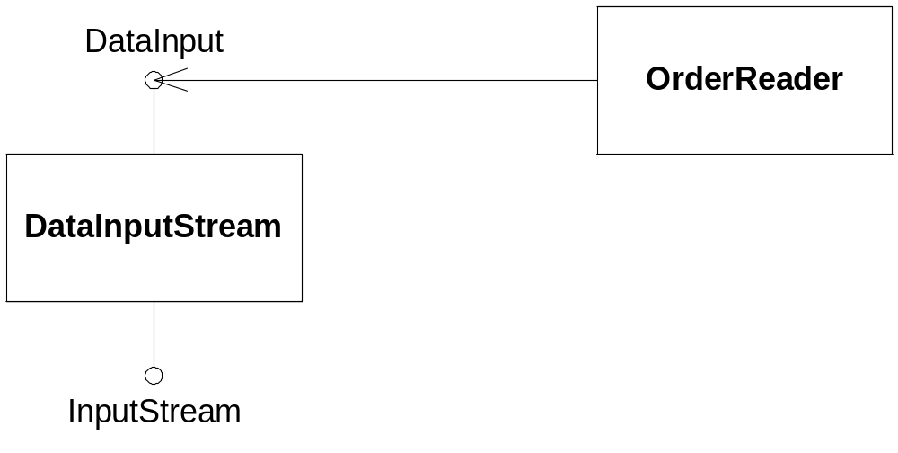
Interface Diagram

Slide 14
Component Diagrams
A Component is an artifact with a well-defined interface boundary
  like a library, or a COM component

Slide 15
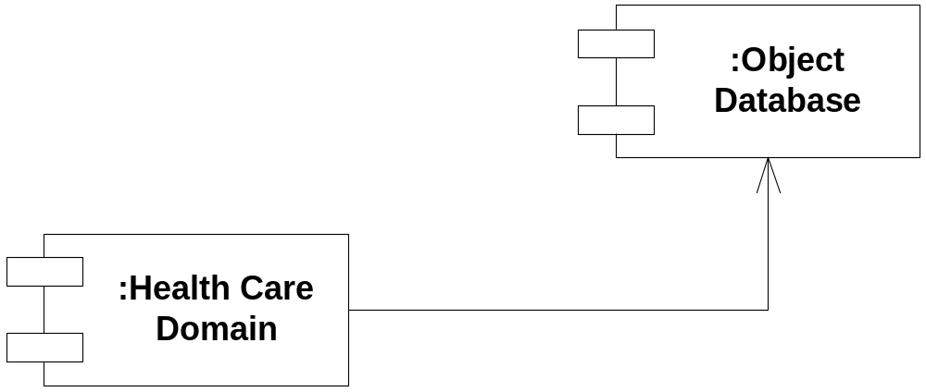
Component Diagram

Slide 16
Collaboration Diagrams
An Interaction Diagram
Shows Links between objects
Sequence shown by numbering

Slide 17
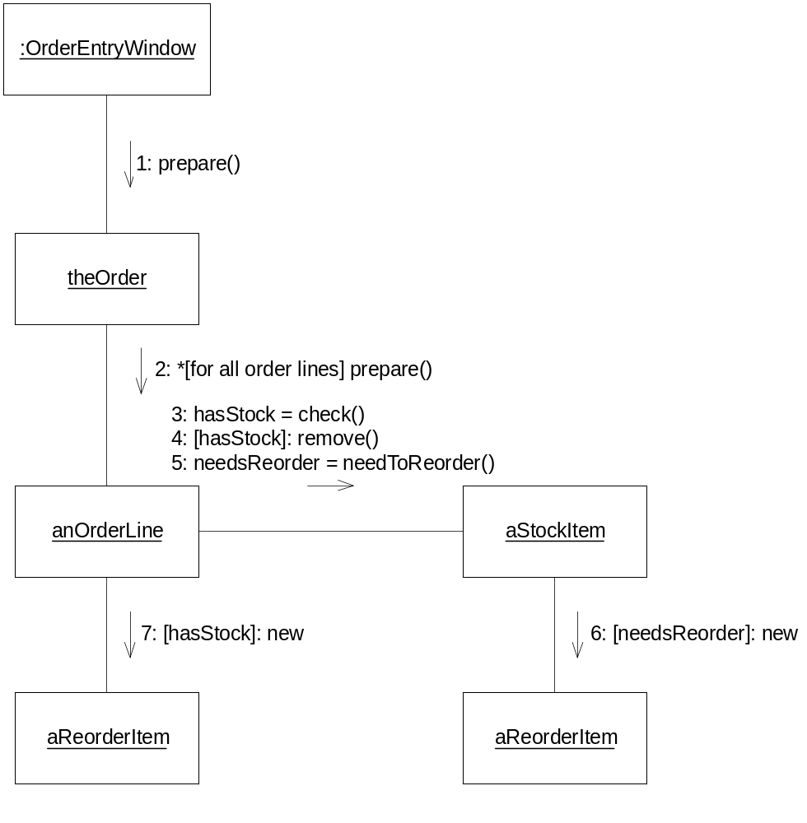
Collaboration Diagram

Slide 18
Behavioral Diagrams
Sequence
State Machine
Activity

Slide 19
Sequence Diagrams
Similar to Collaboration Diagrams
Sequence visible via object lifeline

Slide 20
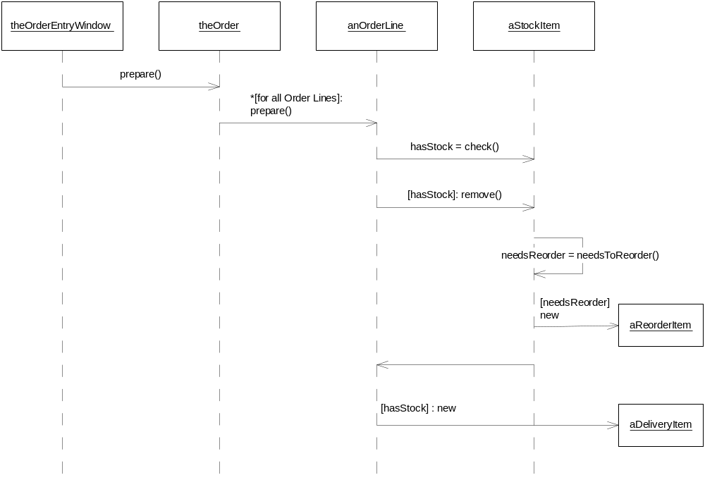
Sequence Diagram

Slide 21
State Diagrams
Classical State Machine Diagram
Records complicated interactions governed by state
Can show concurrency

Slide 22
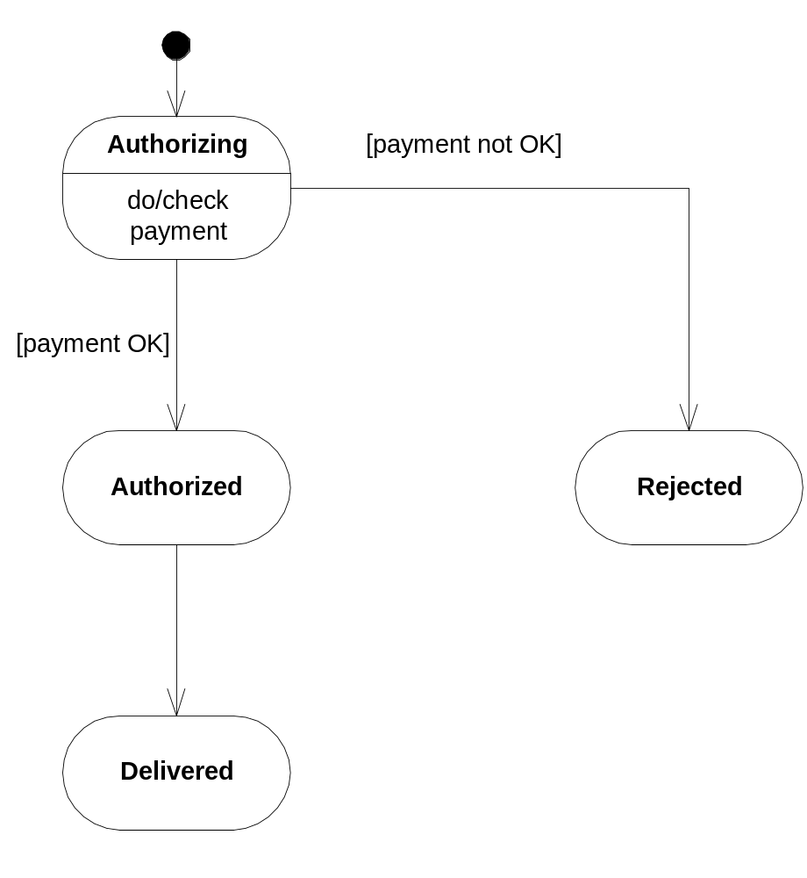
State Diagram

Slide 23
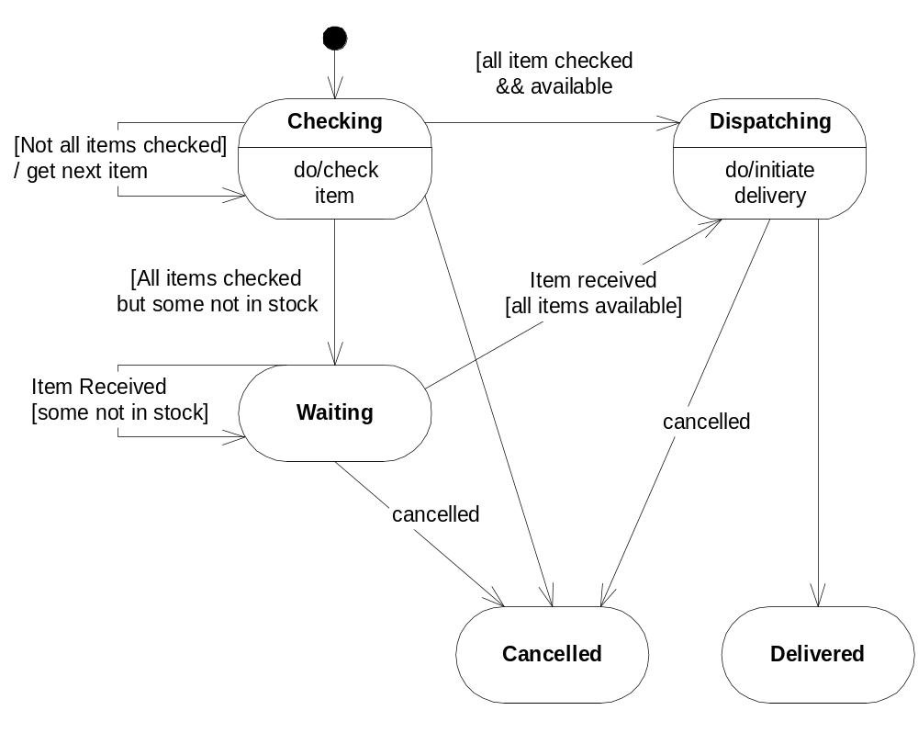
State Diagram

Slide 24
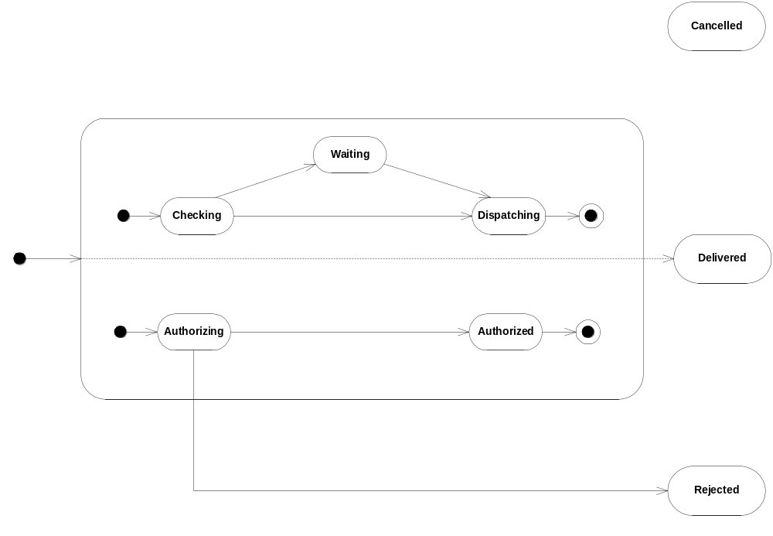
Concurrent State Diagram

Slide 25
Activity Diagrams
A sequence diagram for tasks
  instead of objects
Show tasks and their relationships

Slide 26
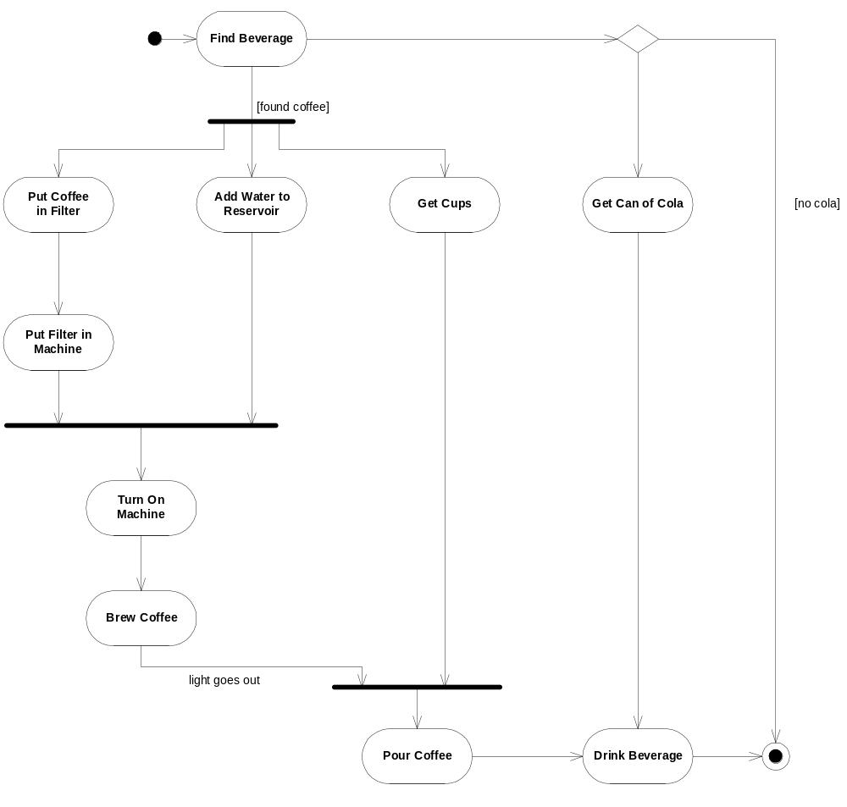

Slide 27
Grouping Diagrams
Package
Deployment

Slide 28
Package Diagrams
A System Decomposition Diagram
For Partitioning into Modules
  often groups of classes
Useful to show dependencies among modules

Slide 29
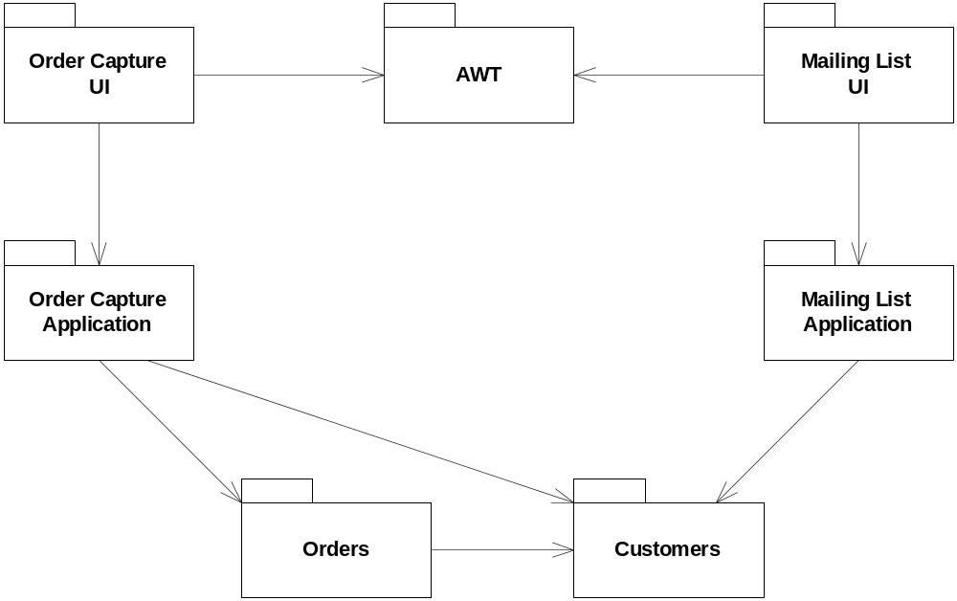
Package Diagram

Slide 30
Deployment Diagrams
Depict the Relationships between components of a system

Slide 31
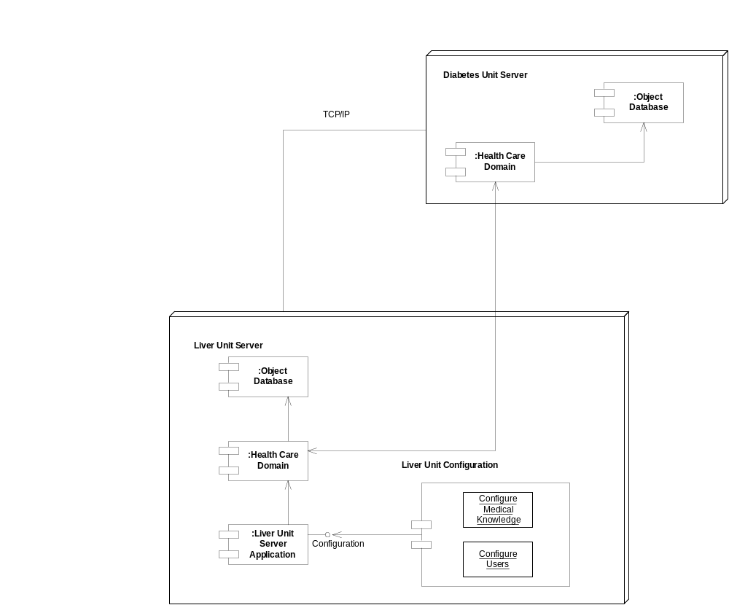

Slide 32
Relationships
Dependencies
Associations
  aggregation
Generalization (Inheritance)

Slide 33
Dependencies
Merely shows that if one element changes, then the dependent element is affected
Denoted by -------→

Slide 34
Associations
At the most general level, indicates nothing more than some “connection”
  unadorned straight line between two elements
  can include cardinality

Slide 35
Aggregation
A part-whole relationship
Also called “containment” or “composition”
Uses a diamond icon on the association line
Composition is special:
  means contained object is not shared
  uses a filled-in diamond

Slide 36
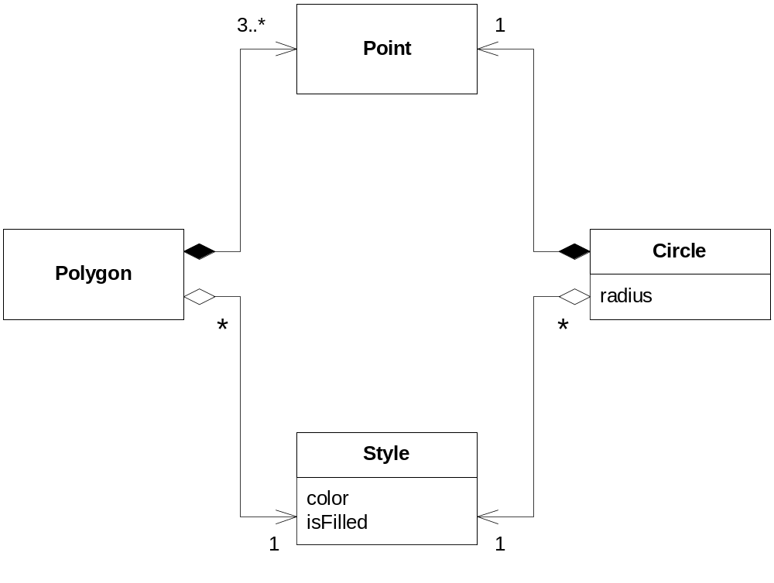
Aggregation & Composition

Slide 37
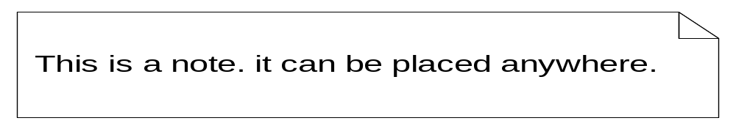
Notes
Just a Note!

Slide 38
Summary
Everybody’s using it
Use what applies to your system
Free Visio Templates available on Web
Book: UML Distilled, Martin Fowler, AW, 1997.

